Slide 1

Appeal against the decision of the MPT: Proposed rezoning, subdivision, consolidation & departures:
Conrad Hospital Site:
Pinelands Ratepayers & Residents Association
Kensington-Factreton Ratepayers
Thornton Ratepayers
Maitland Ratepayers

Slide 2
Background
The Municipal Planning Tribunal, at its Special Meeting held on 11 October 2017, considered an application from ARG Design for:
“1. The subdivision of –
Remainder Erf 112656 and Remainder Erf 112657 into two portions each.
2. The consolidation of –
(a) Erf 112656 with the alienated portion of Erf 112657. This will contain the Orthotic and Prosthetic Centre.
(b) Erf 112657 with the alienated portion of Erf 112656 which will become the focus of this development application.
3. The erf in 2(b) will be subdivided to form two superblock subdivisions which will be subdivided further at a later stage.
4. The rezoning of the superblocks from a Limited Use Zone to a Subdivisional Area to accommodate portions of land zoned for
Mixed Use, Sub-zone MU2,
General Residential, Sub-zone GR5,
A Transport Zone 2: Public Street and Public Parking (TR2) zones and
Open Space Zone: Special Open Space 3 (OS3) to accommodate private open space on the property
5. Departures required to permit
a. A reduced ratio 0.5 parking bays will be provided per dwelling unit. Shared parking will exist between the retail, service industry and office activity.
b. A building line of 0m in lieu of 4.5m above 10.0m on the MU2 site.
c. An earthbank/retaining structure (berm) along the south-eastern extent of the property to be 3.0m in lieu of 2.0m.

Slide 3
Decision of the Municipal Planning Tribunal
At its meeting on 11 October 2017, the Municipal Planning Tribunal resolved as follows:
The application for the subdivision … BE APPROVED in terms of Section 98(b) of the Municipal Planning By-Law …
The applications for the consolidation … BE APPROVED in terms of Section 98(b) of the Municipal Planning By-Law …
The application for the rezoning of the property from a Limited Use Zone to a Subdivisional Area … BE APPROVED in terms of Section 98(b) of the Municipal Planning By-Law …
The applications for the departures … BE APPROVED in terms of Section 98(b) of the Municipal Planning By-Law …”

Slide 4
Reasons for the Decision of the Municipal Planning Tribunal (1)
The applications for the subdivisions, consolidation, rezoning and departures comply with the requirements of Section 99(1) of the
MPBL for the following reasons:
The applications comply with the MSDF
All the applications required in terms of the MPBL have been applied for and relevant public participation processes followed
The application complies with the City’s development principles, as contained in its Integrated Development Plan (IDP)

Slide 5
Reasons for the Decision of the Municipal Planning Tribunal (2)
The considerations in Section 99(2) of the MPBL have been taken into account in respect of City policies and are considered compliant for the following reasons:
The proposal will result in intensification and densification of the land where development on the site was previously sparse
A diverse range of land uses will be accommodated on the property
Accommodation will be provided for various socio-economic income groups
The site is accessed by various modes of public transport
The property provides access to opportunity being located close to and providing access to, places of employment and various services and amenities
The proposal will also provide opportunities for employment
Densification and intensification of land contribute toward the restructuring of the City and ensures better utilization of the service infrastructure
Reducing parking provision ensures improved thresholds for public transport use
Shared parking also ensures the better utilization of parking provided on-site.

Slide 6
Reasons for the Decision of the Municipal Planning Tribunal (3)
All considerations in respect of Section 99(2) of the MPBL have been taken into account in the assessment of the above application which are considered to be desirable in terms of Section 99(3) of the MPBL for the following reasons:
Short and long term employment opportunities will be created
The mixed use development is suitably located being surrounded by residential, business and industrial uses
There will be no adverse impact on the service infrastructure as either sufficient capacity exists or improvements to the services infrastructure will be necessitated to accommodate the proposal
The development of the property ensures the better utilization of the land which presently stands vacant
Heritage components will be incorporated into the development
It will result in road improvements that will offer wider connections to various parts of the City
The reduced parking ratio is considered rational as the site is located within a public transport corridor
The proposal complies with LUPA and SPLUMA principles
This is an attempt at addressing one of the City’s most critical challenges, i.e. the need for affordable housing in accessible locations
Suitable attenuation measures will be put in place to address stormwater management related to the 1:100 flood line.

Slide 7
Grounds for Appeal (1)
Whilst the Associations have repeatedly expressed their support for the development of the Conradie site, we believe that the proposed development:
falls short of the Western Cape Government’s Better Living Model that the project professes to be a “blueprint” for
fails to comply with the requirements of the MPBL.

Slide 8
Grounds for Appeal:
Process & Procedure
The public participation process was flawed
sufficient time must be afforded to interested and affected parties to gather as much information as possible about the proposal and to consider the proposal and its wider impact on existing and future communities before making an informed decision
these processes must be meaningful engagements where the concerns, misconceptions and proposed solutions advanced by participants be seriously considered and be seen to be addressed.
It is our experience throughout the planning processes and particularly during the formal comment period for the land use application, that our interactions with the applicant / developer / authorities were merely “tick-box” exercises to satisfy relevant legislative requirements

Slide 9
Grounds for Appeal:
Decision-maker must consider all relevant considerations (Section 99(2) of the MPBL)
Section 99(2) of the MPBL requires the decision-maker to consider (amongst others)
…
…
any applicable policy or strategy approved by the City to guide decision making …
the extent of desirability of the proposed land use …
…
…
other considerations prescribed in relevant national or provincial legislation …”

Slide 10
Applicable Policy / Strategy
The Tribunal incorrectly applied the guidelines contained in the Densification Policy
The Tribunal failed to address the issue that we raised – that of inappropriate densification
the Cape Town Densification Policy, 2012, states that the “general land use character of an area is important when considering the suitability of higher density development.
If an area is solely single-dwelling residential, greater attention needs to be given to height and form of new developments than where flats and other forms of mixed land use development already exist
the application of the guiding principles of the City of Cape Town Densification Policy is incorrect and that the proposed development is therefore not compliant

Slide 11
The applicant has expressed the fear that the project viability may be negatively impacted should the densities be lowered
Whilst we do recognise the need for the project to make financial sense from the developer’s point of view, financial viability, however, is not a criterion for consideration when deciding on applications in terms of the City of Cape Town Municipal Planning By-Law.

Slide 12
The Tribunal incorrectly applied the guidelines of the Social Development Strategy
the site is contained and isolated from surrounding communities (canal, railway line, etc) and considerable attention therefore needs to be given to overcoming these barriers in order for us to realise a more integrated and inclusive society
This increases the need for the provision of facilities such as schools within the development itself.

Slide 13
Extent of Desirability
Compatibility
The proposed development will have no residential structure that is lower than 13m (4 storeys) in height, with the highest buildings being 25m (8 storeys) high. Whilst we concur that the proposed land use can be described as predominantly residential, the correct categorisation would be medium- to high-rise residential
The predominant land use surrounding the site can be described as low rise residential development, with the exception of the areas closest to Thornton Station (3 storeys) and at Anfield Village (3 storeys)
The proposed development of up to 25m high residential buildings is therefore not consistent with the Densification Policy

Slide 14
Impact on safety, health & wellbeing of the community
The applicant’s own motivation report shows that the applicant is, at the very least, uncertain in respect of the provision of education facilities
provision is only made for private schools in the proposed development
50% of units to be provided (1 804) will be grant funded and may therefore not be for people who are able to afford any other schooling than public schooling. With the only public schools located outside of the proposed development, learners from households in this income category will have to commute to school. Once again the poor will be at a disadvantage - leaving home earlier and arriving back later
It is therefore not only the wellbeing of the current surrounding community that will be compromised as a result of non-provision of schools, but also that of the recipient community.

Slide 15
Parking
A study by the Development Bank of Southern Africa (2007) indicates, amongst others, that “all aspects of car use are strongly correlated with household income. The higher the household income (especially when it rises above R3 000 per month) the more likely it is that household members will have access to and make use of a car”. According to the study 47.9% of households in the income bracket R3 001 – R6 000 per month had access to a car and 23.7% of the work trips of this group was made by car, as driver
According to StatsSA’s National Household Travel Survey (2013), “in households where income exceeds R6 000 per month, 82% have access to one or more cars”
A reduction in the use of private vehicles does not necessarily relate to a reduction in ownership of private vehicles
It is not uncommon for those in the income categories targeted for this development to commute to and from work during the week and still have access to a car for use over weekends and at night. These vehicles will need parking bays when not in use. No flexibility is built into the design

Slide 16
Conclusion
Chapter 8 of the National Development Plan: “transformation of human settlements and the national space economy” reaffirms the priority to restructure spatial divides, as well as to enhance the spatial economy to address inequality and economic efficiencies.
The transformation objectives are to ensure human settlements are “liveable, equitable, sustainable, resilient and efficient, which support economic opportunities and social cohesion” (National Planning Commission, 2012:263).

Slide 17
We , the neighboring Communities want to avoid the reality of a slum being built and the poor residents once again being marganilized.
We want to leave the Committee with these Photos & Press:
“The transformation objectives are to ensure human settlements are
“liveable, equitable, sustainable, resilient and efficient,
which support economic opportunities and social cohesion”
(National Planning Commission, 2012:263).
… as an example of what “well meaning design/planning on paper”
re : how low cost housing and rental opportunities actually turns into reality , when people live there…”

Slide 18
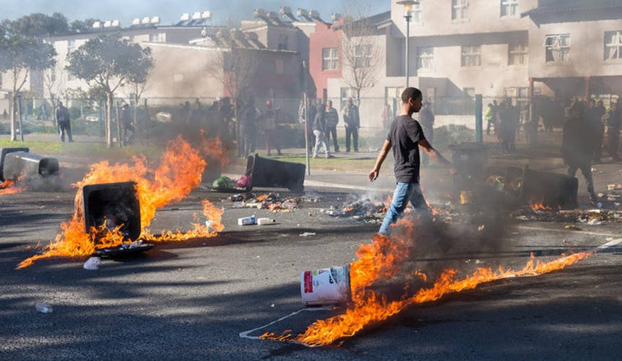
GroundUp: What happens when people in state housing cannot pay the rent?
Daily Maverick : 05 Dec 2017
Steenvilla, Cape Town’s largest social housing complex

