Slide 1

STREET PEOPLE PROGRAMME
Vulnerable Groups and Communities

Slide 2
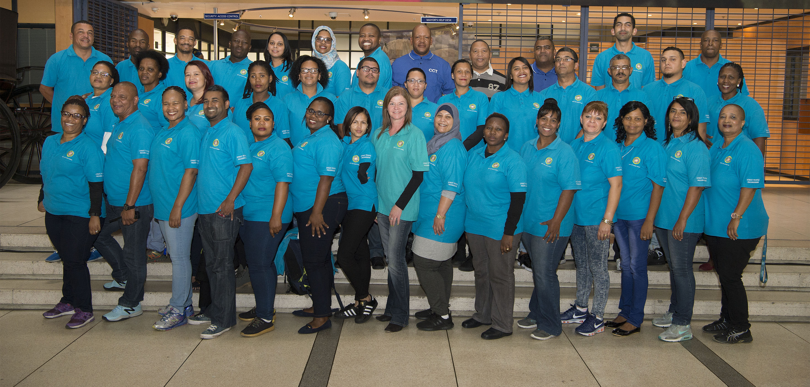
Introduction –Street Peoples Programme

Slide 3
INTRODUCTION
The street people programme was introduced to help persons living and surviving on the streets of the City. The programmes aims to facilitate a developmental approach in addressing the needs of street people.
We aim to restore a sense of human dignity amongst the people we engage with.
Services include:
relocation of street people to various shelters in the City and to newly launched Culemborg Safe Space for Street a People
reunification of street people back into their family and community of origin
assistance with access to ID’s and grants
access to substance abuse programmes
developmental opportunities
EPWP opportunities.
The reintegration team conducts public outreach to street people on a daily basis, and also conducts a series of community awareness projects focusing on giving responsibly.

Slide 4
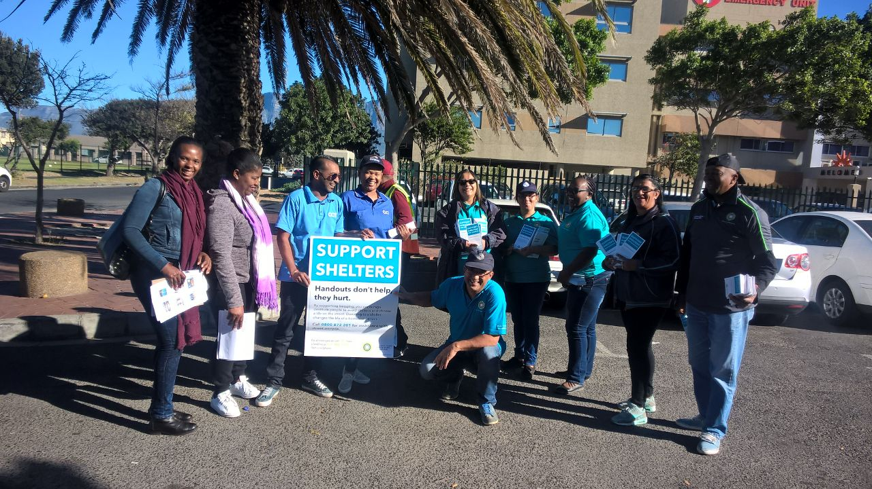
Team Structure

Slide 5
STATISTICS
Number of EPIC (107) street people complaints closed from June 2017 to June 2018 just under 5000 (complaints have decreased by 50% since previous financial year)
Number of street people engaged and assisted through our services from June 2017 to June 2018 - 2200
Number of street people placed in shelters during winter readiness programme 15 May 2017 – current 1100
Number of persons reunified with families and off the street permanently from July 2017- July 2018 – 160 (an increase by 50% since previous financial year)

Slide 6
FOCUS AREAS
Street People programmes:
Daily interventions conducted via EPIC and other means of correspondence
Winter Readiness Programme : aims to provide emergency bed space and support to registered organisations providing services to street people during the winter period due to increased demand for services during winter.
Give Responsibly Campaign – aims to raise awareness on giving responsibly
Grant in aid programme – developmental programme for 100 street people being piloted
World Homeless Day – Various events held annually for Street people
Local Networks of Care established – NGOs supporting early intervention programmes for vulnerable groups that may gravitate towards the street
Culemborg Safe Space for Street People
7

Slide 7
ROLE OF THE REINTEGRATION UNIT
FIELD OFFICERS:
  Are responsible for outreach work in their demarcated area and responding to complaints. This entails screening, data collection and offering social assistance to the street person.
REINTEGRATION OFFICERS:
  Are responsible for case management of clients willing to accept assistance. Once a client has accepted the social assistance, the client is relocated to a shelter temporarily whilst the reintegration officer establishes whether the client can be reunified with his/her family and identifies additional needs of the client in respect of other services e.g. health services, mental health services, substance abuse interventions etc.

Slide 8
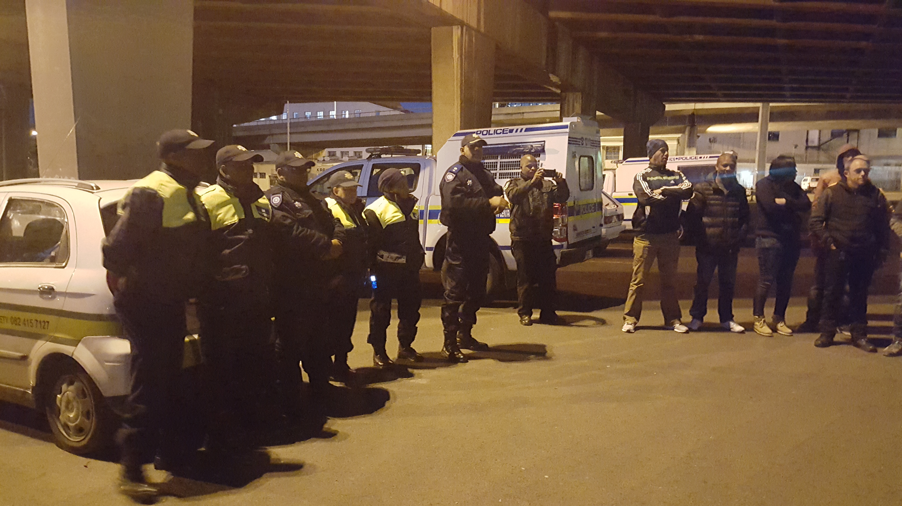
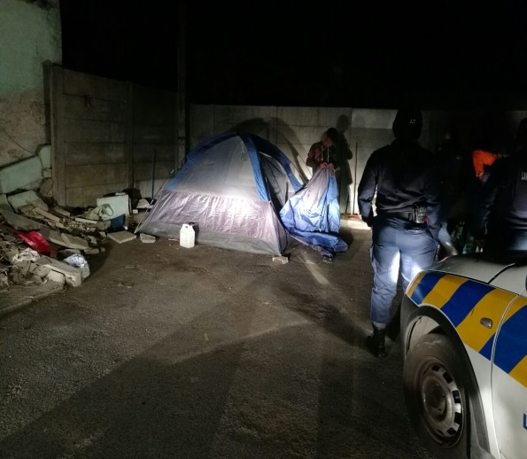
INTERVENTION WITH LAW ENFORCEMENT
The street people unit engages a person and offers social assistance.
The unit engages with a person on six occasion, when the person still refuses assistance, the matter is referred to the re established Displaced Persons Unit who will attend to by-law infringements.

Slide 9
NEW INITIATIVES
Grant-in-Aid : We are piloting a programme for the development and diversion of 100 street people
The Department has established a safe space for street people under the Culemborg bridge in the CBD this includes:
Safe area to overnight
Social and health services
Locker facilities
Ablution facilities
EPWP and skills development opportunities

Slide 10
SAFE SPACE FOR STREET PEOPLE BACKGROUND
The Social Development Strategy (SDS) identifies street people as a particularly “vulnerable group that requires assistance to achieve reintegration into communities and access to employment opportunities”.
Research conducted in 2015, indicated that there are currently 7383 homeless people
      4862 people living on the street and
      2521 people living in shelters which gives a
    TOTAL of 7383 people.
    The age group of people living on the street is between 18 years and 66 years.
    79% of street people are male and 21% is female.
Whilst some persons agree to relocate to shelters, 75% of persons living on the street prefer to remain on the street when offered social assistance to reintegrate into mainstream society.
The result being that people choosing to live on the street are located in 37 “Hotspot” areas and the consequences of the antisocial behavior often demonstrated in this population, often result in by-law infringements.

Slide 11
BACKGROUND
With this it mind, It then became prudent to investigate temporary containment measures to address and alleviate the increasing number of by-law infringements currently requiring intervention in the street people population, whilst working towards reintegration back into society.
In the Mayor’s unblockage meeting in September 2016, an instruction was issued to create 8 safe spaces across the metropole.
A process of identification of possible sites then ensued as well as engagement with people living on the street to determine what their needs are and what could potentially be a response to their needs.
People living on the street identified the following needs:
  Safe space to sleep at night
  Space to store their belongings at night
  Ablution facilities
  Space to cook their food so that they don’t make fires on the street
  Space to wash their clothes

Slide 12
BENEFITS OF A SAFE SPACE FOR HOMELESS PEOPLE
Most shelters are at maximum capacity, the safe space will provide a controlled transition area for up to 230 street people in the CBD
Provides a drug free/alcohol free/weapon free safe space for homeless persons
May reduce the amount of temporary shelters and accumulated waste in Cape Town
May reduce the amount of joint operations with Law Enforcement to remove temporary shelters, saving on manpower and resources cost
Provision of social services and psychosocial support which may increase the numbers reunified with families or their community
Provides the opportunity for street people to take part in EPWP programmes therefore reducing begging/aggressive begging on the street
Reduces the amount of human waste in and around the City
Provides a contained space for NGO’s to offer services to homeless people

Slide 13
Launch of Culemborg Safe Space for Street People
The site is under the Culemborg Bridge along Old Marine Drive Roggebaai
The space was opened on 29 June2018
We accommodated 15 street people from 29 June to 17 July to test the intake system
The site was launched on 17th July
There are currently 55 street people using the space
The site will be fully operational by the end of August
Services include:
City Health and Matrix programmes
Social services
Reunification programme
EPWP opportunities
Skills Development opportunities

Slide 14
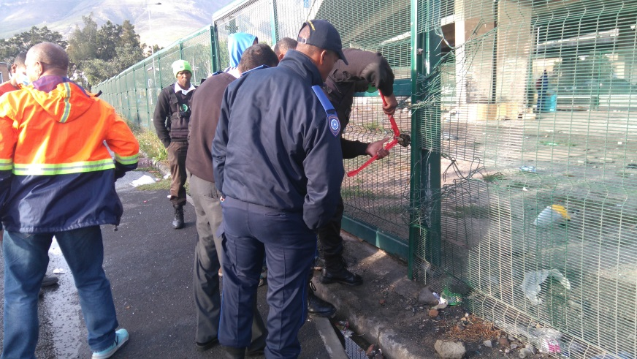
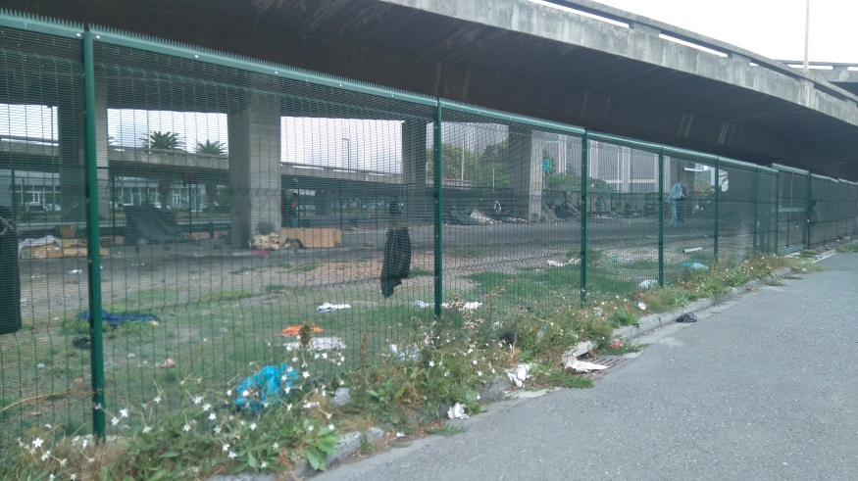
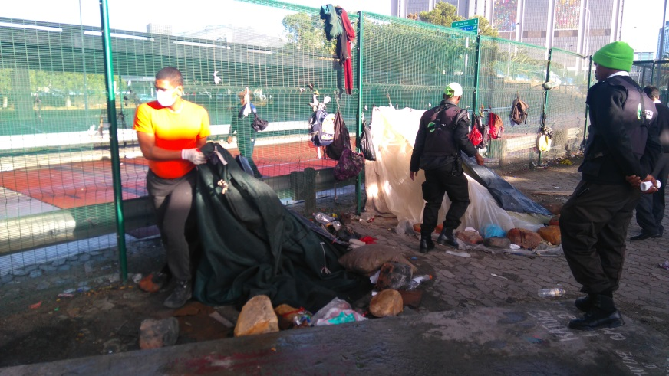
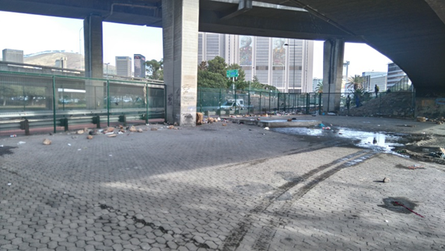
Culemborg space before construction

Slide 15
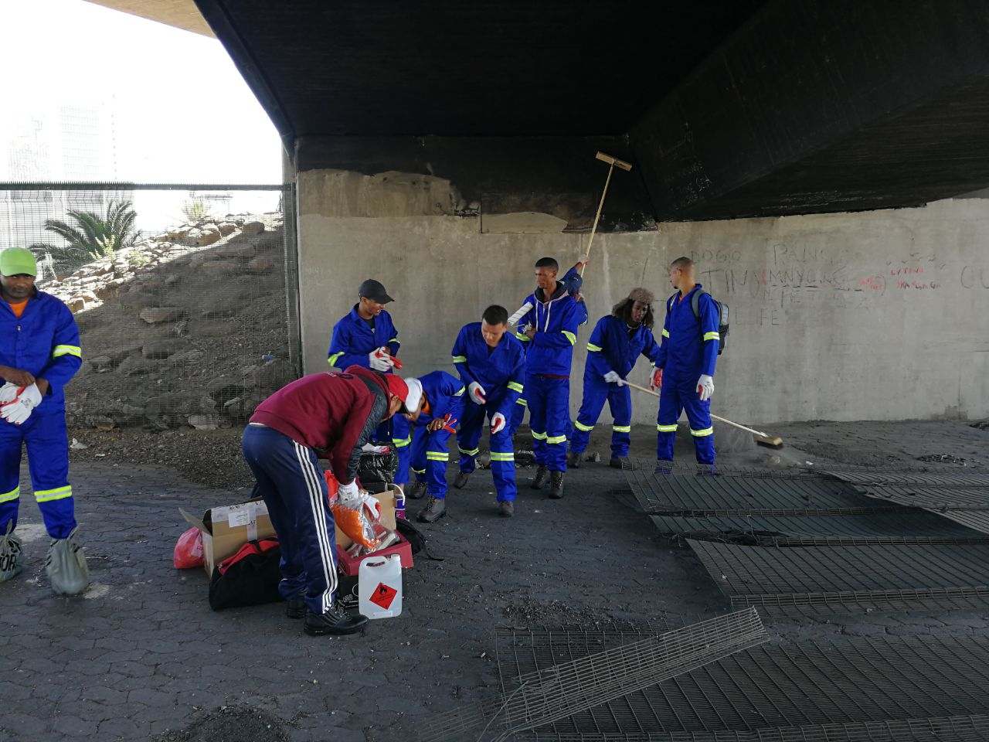
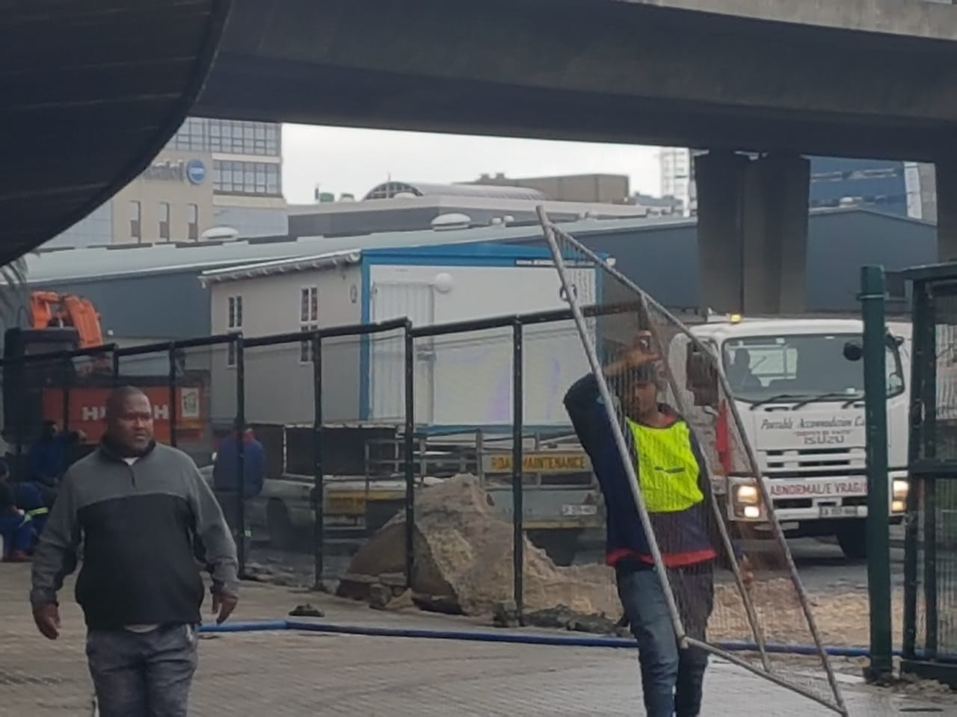
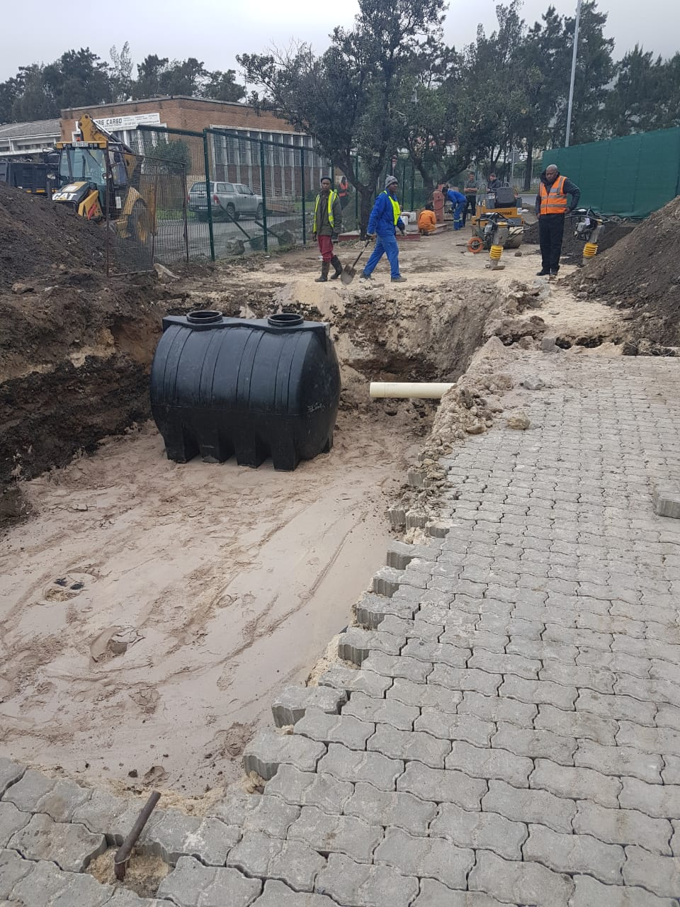
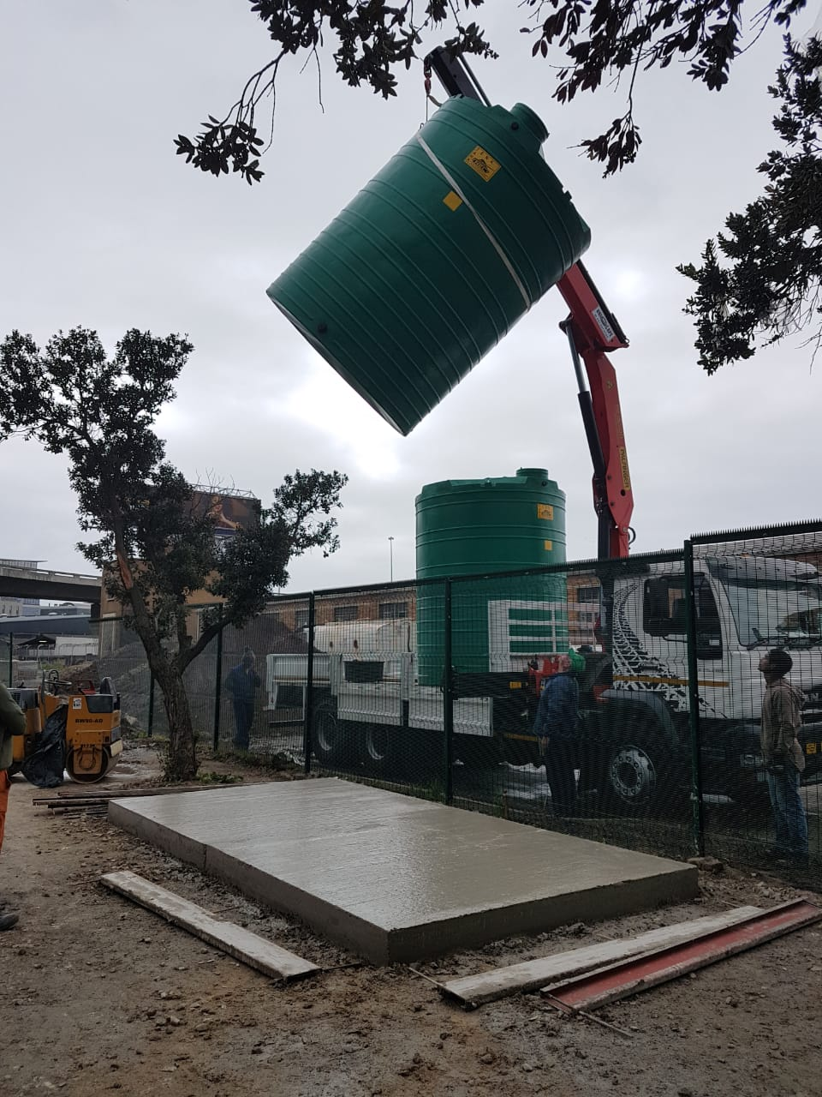
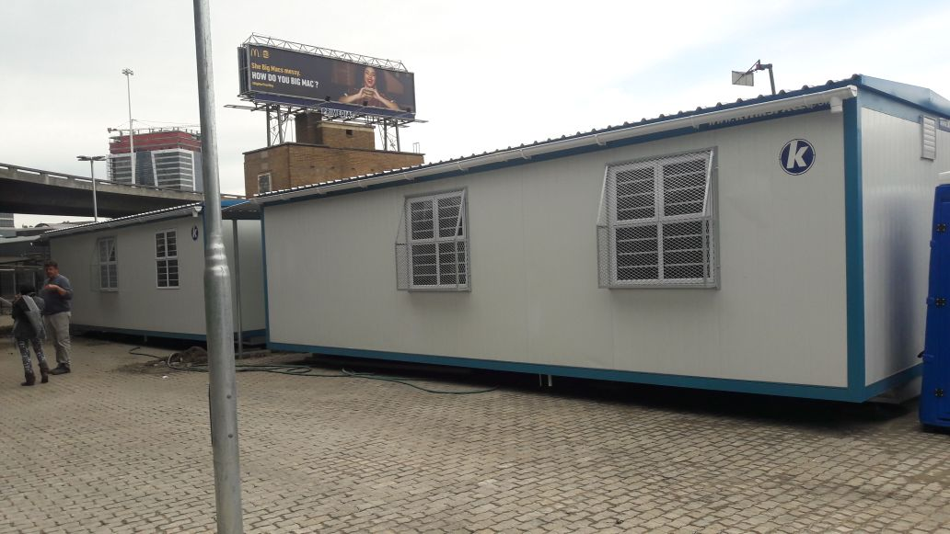
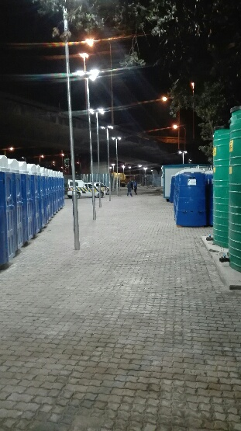
Site prep

Slide 16
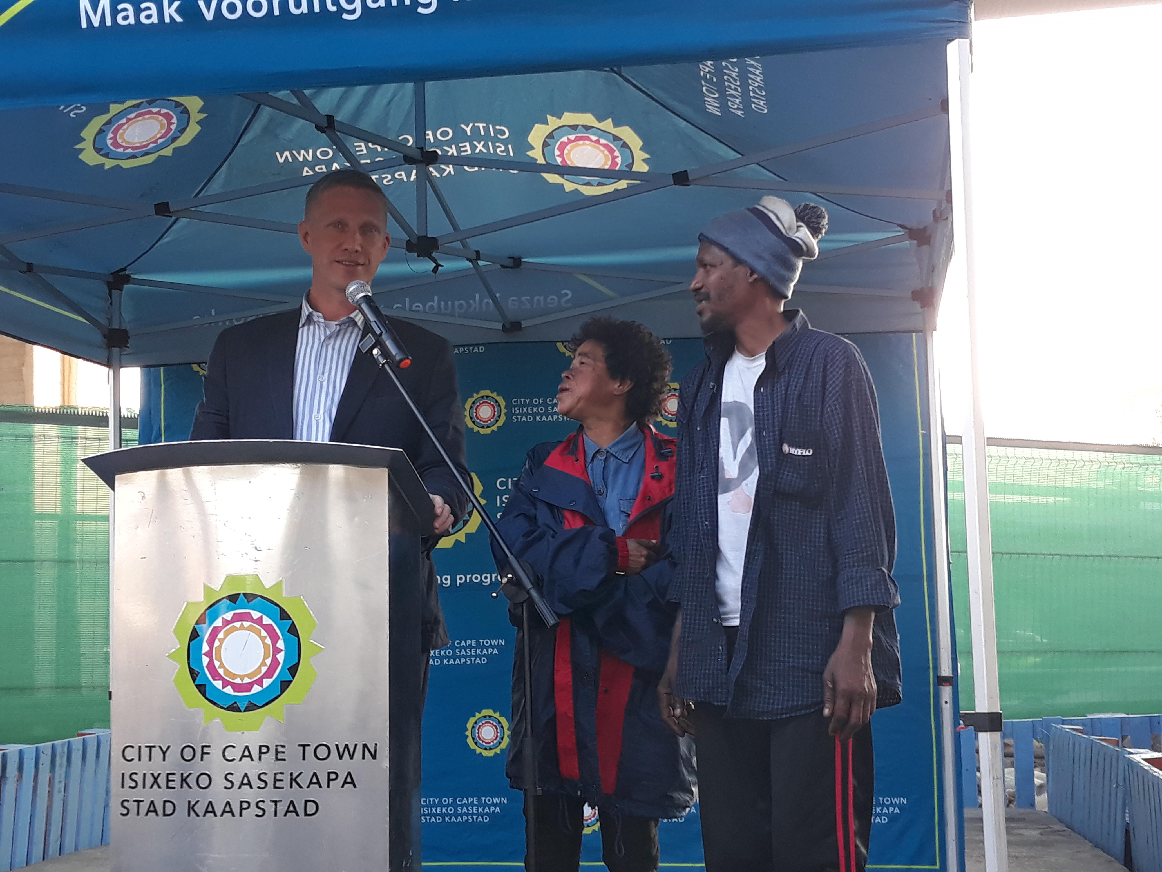
OUR FIRST CLIENTS

Slide 17
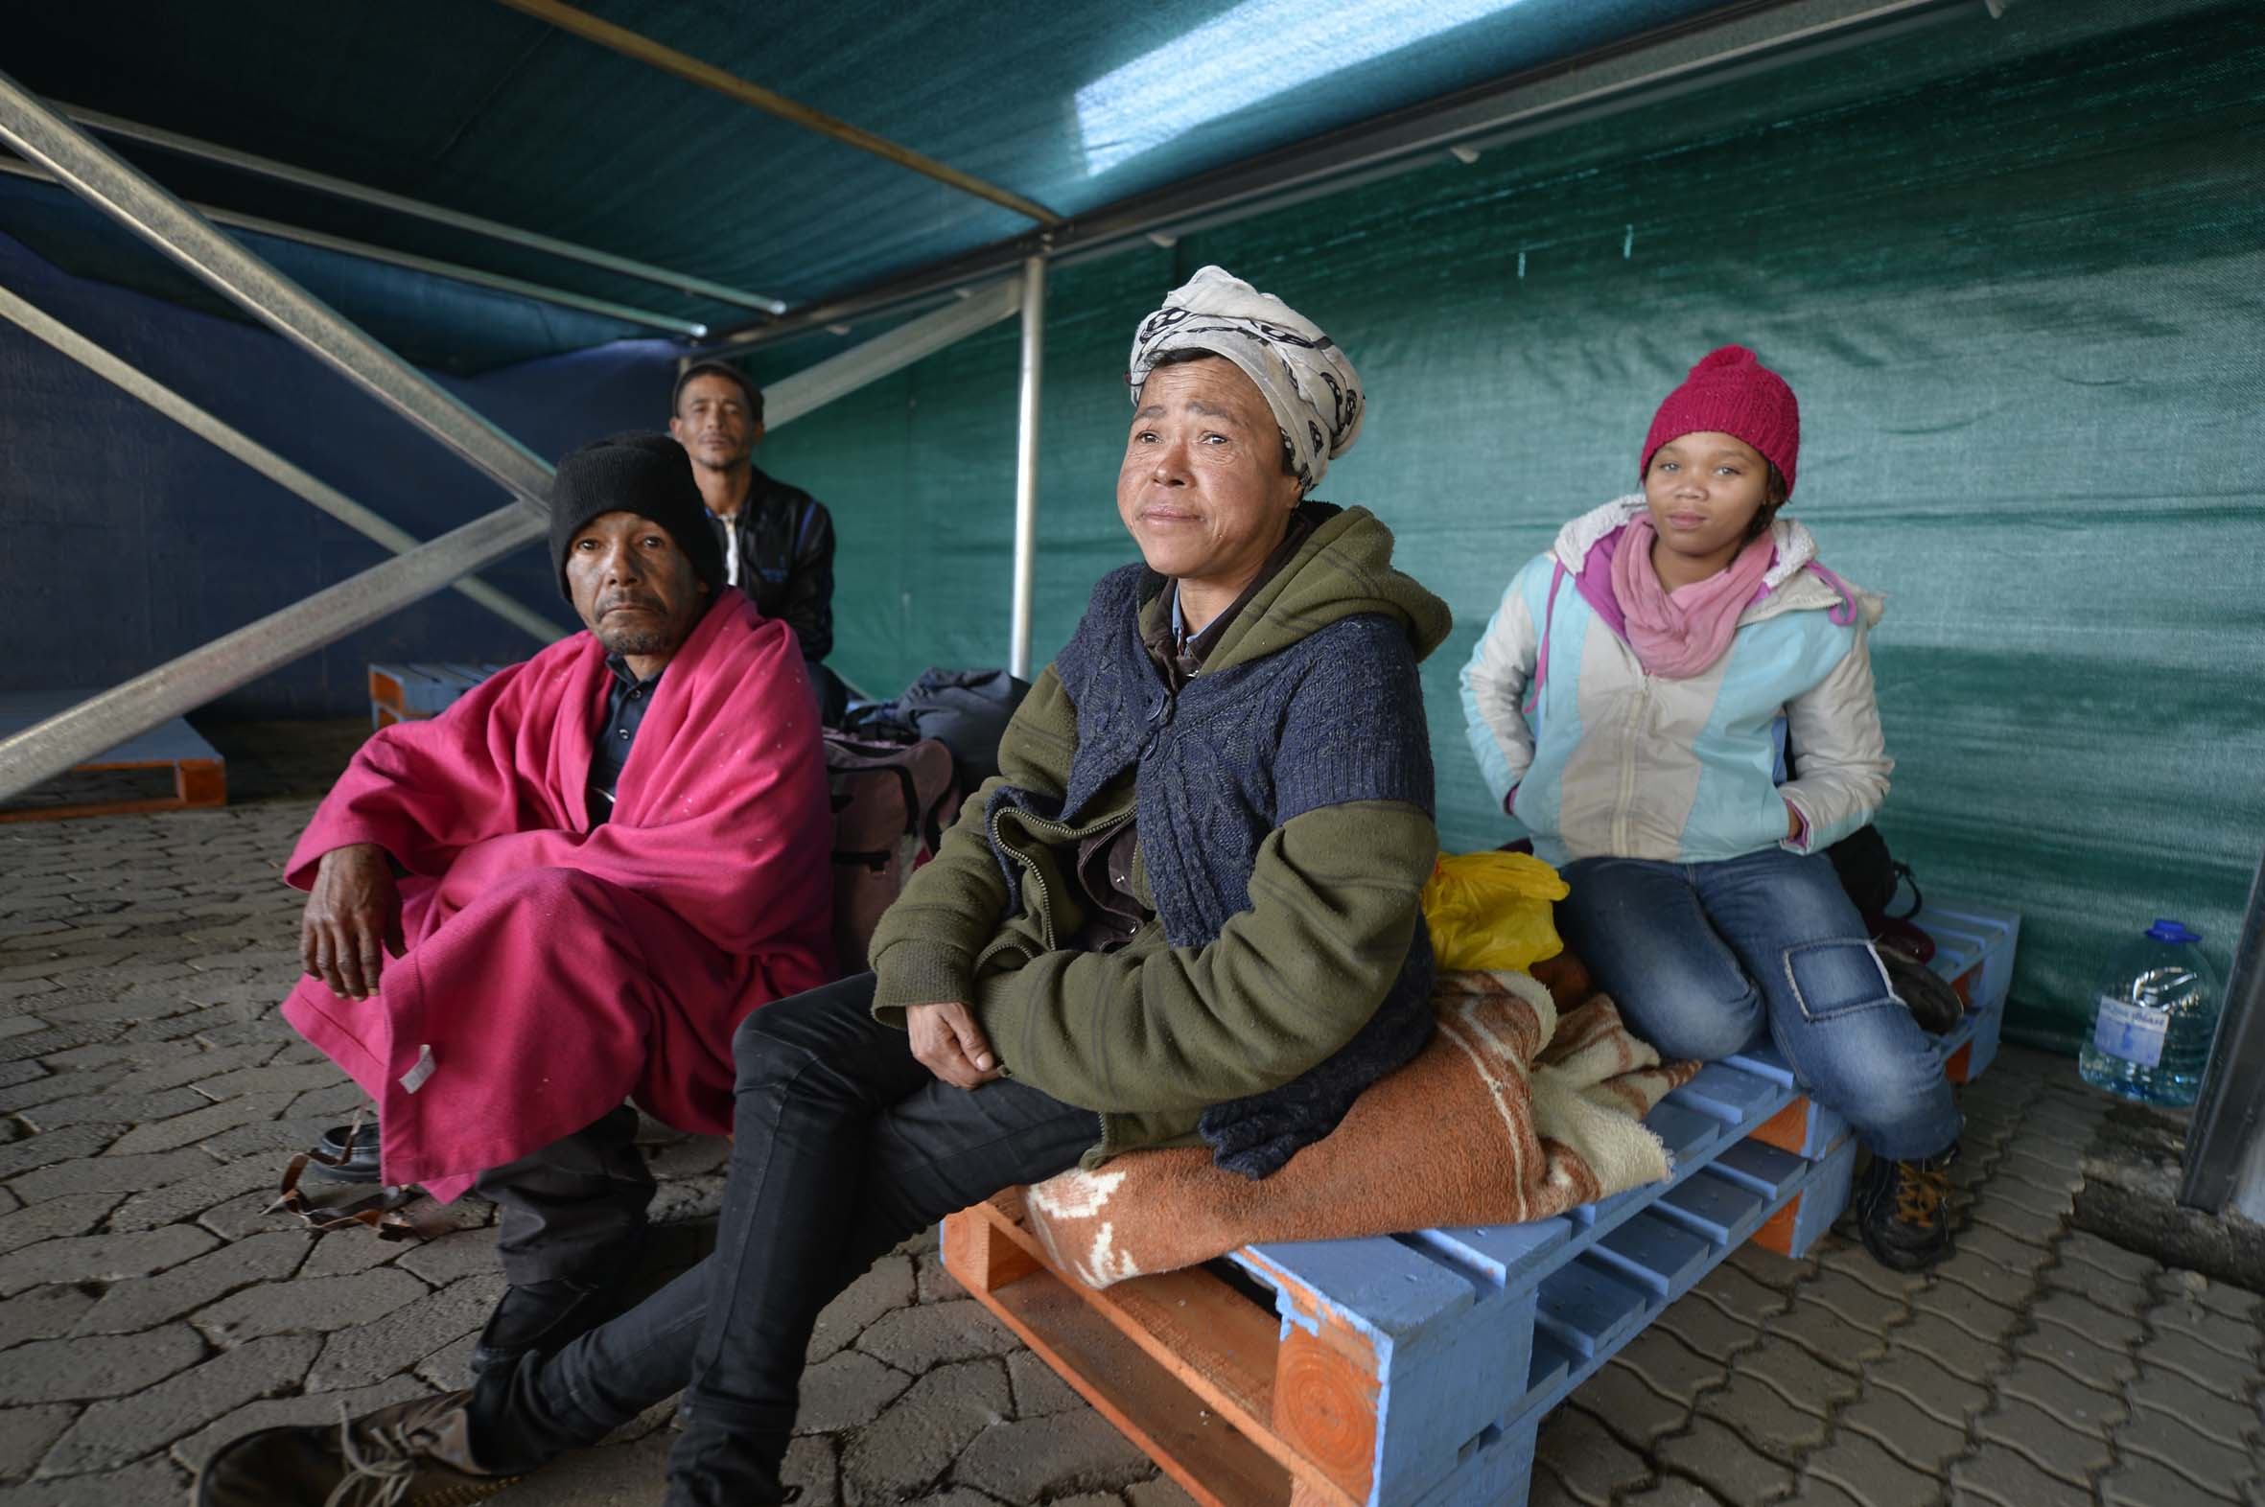
CLIENTS

Slide 18
For queries contact Lorraine.Frost@capetown.gov.za

